Slide 1

Reorder Point in Operations Management
~Umar Mukhtar
Notes:
~ Umar Mukhtar

Slide 2
Introduction to Reorder Point (ROP)
The Reorder Point (ROP) is the inventory level at which a company should place a new order to replenish its stock. It is a critical element in supply chain and inventory management, acting as a trigger to prevent stockouts and ensure continuous operations.
A well-defined ROP helps businesses balance the costs of holding inventory with the risk of running out of stock. By understanding and implementing an effective ROP strategy, companies can optimize their inventory levels, improve customer satisfaction, and enhance overall operational efficiency.

Slide 3
Understanding Inventory Management
Inventory management involves overseeing the flow of goods, from raw materials to finished products. Effective inventory control is essential for maintaining optimal stock levels, minimizing costs, and meeting customer demand. Various inventory types exist, including raw materials, work-in-progress, and finished goods.
Challenges in inventory control include demand variability, lead time fluctuations, and the risk of obsolescence. The Reorder Point (ROP) plays a crucial role in avoiding stock outs by providing a clear signal for when to replenish inventory, ensuring that businesses can meet customer needs without excess stock.

Slide 4
Formula of Reorder Point
The Reorder Point (ROP) is calculated using the formula: ROP = (Average Demand × Lead Time) + Safety Stock. Average demand represents the typical quantity of goods sold or used during a specific period. Lead time is the time it takes for a new order to arrive after it has been placed.
Safety stock is the extra inventory held to buffer against unexpected demand surges or lead time delays. For example, if a company has an average daily demand of 50 units, a lead time of 5 days, and a safety stock of 100 units, the ROP would be (50 × 5) + 100 = 350 units.
With safety stock:
Without safety stock:
ROP = (Average Demand × Lead Time) + Safety Stock
ROP= daily average sales × lead time

Slide 5
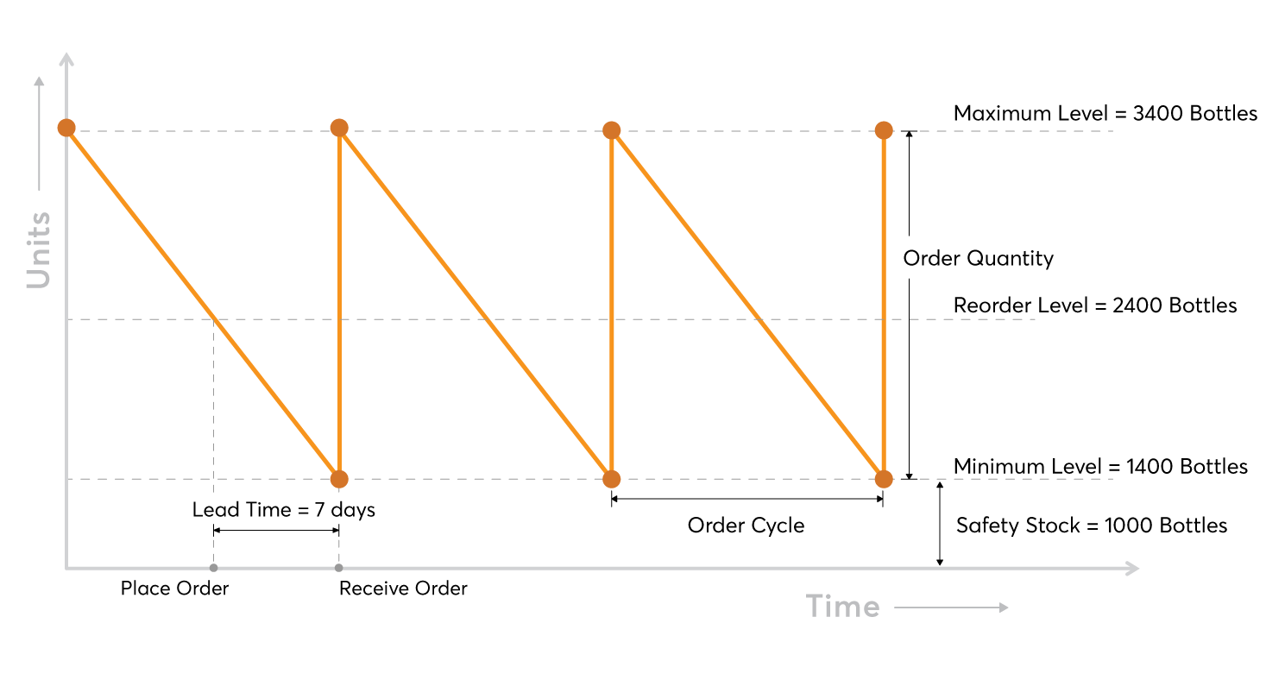
Graph

Slide 6



Factors Affecting Reorder Point
Several factors influence the determination of the Reorder Point (ROP). Demand variability, or fluctuations in customer demand, can significantly impact ROP. Higher demand variability requires a larger safety stock to prevent stockouts. Lead time fluctuations, or variations in the time it takes for orders to arrive, also affect ROP.
Longer and more variable lead times necessitate a higher ROP. Safety stock considerations involve determining the appropriate level of extra inventory to hold. Supplier reliability is also a factor, as unreliable suppliers may require a larger safety stock to compensate for potential delays.
2
Lead Time Fluctuations
Demand Variability
1
3
Safety Stock Considerations

Slide 7
Reorder Point in Different Inventory Models
The Reorder Point (ROP) is applied differently in various inventory models. In the Economic Order Quantity (EOQ) model, ROP helps determine when to place an order for the optimal quantity. In Just-in-Time (JIT) and Lean Inventory Management, ROP is minimized through close coordination with suppliers and efficient production processes.
Push systems, where inventory is pushed through the supply chain based on forecasts, rely heavily on accurate ROP calculations to avoid excess stock or shortages. Pull systems, where inventory is pulled through the supply chain based on actual demand, use ROP to trigger replenishment only when needed.
Just-in-Time (JIT) & Lean Inventory Management
Push vs. Pull Systems
EOQ Model (Economic Order Quantity)

Slide 8
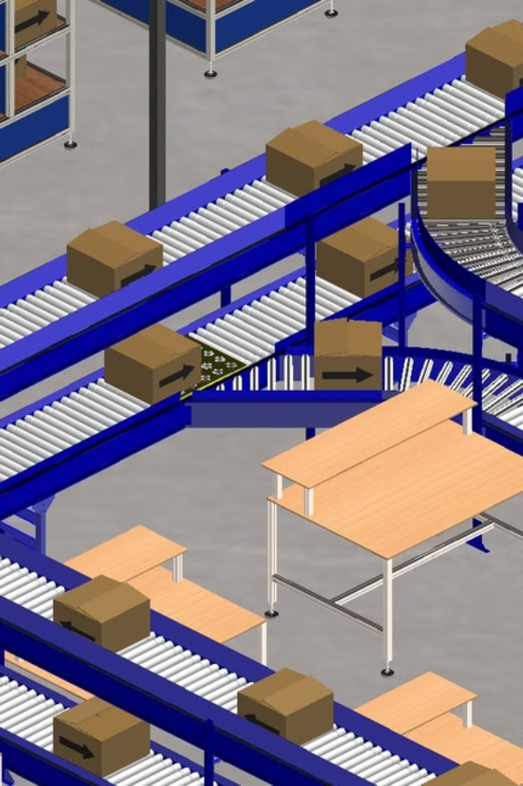
Case Study: Amazon's Efficient ROP Management
Amazon exemplifies efficient Reorder Point (ROP) management through its vast network of warehouses and sophisticated inventory systems. The company uses advanced algorithms and machine learning to forecast demand accurately, taking into account factors such as seasonality, promotions, and historical sales data.
Amazon optimizes its ROP by strategically positioning inventory closer to customers, reducing lead times and improving delivery speeds. They also leverage real-time data and automated systems to monitor inventory levels and trigger replenishment orders, minimizing stockouts and ensuring high customer satisfaction.
1
Demand Forecasting
2
Inventory Positioning
3
Real-Time Monitoring

Slide 9


Reorder Point & Technology
Technology plays a crucial role in modern Reorder Point (ROP) management. Enterprise Resource Planning (ERP) systems integrate inventory data across the organization, providing a centralized view of stock levels and demand. Inventory Management Systems (IMS) automate the ROP calculation and order placement process, improving efficiency and accuracy.
Artificial Intelligence (AI) and Machine Learning (ML) are increasingly used in demand forecasting, enabling businesses to predict future demand with greater precision. These technologies analyze vast amounts of data to identify patterns and trends, helping companies optimize their ROP and reduce inventory costs.
Role of ERP & Inventory Management Systems
AI & Machine Learning in Demand Forecasting

Slide 10
Advantages & Challenges of Using ROP
Using the Reorder Point (ROP) method offers several advantages. It prevents stockouts by ensuring timely replenishment of inventory, minimizing lost sales and maintaining customer satisfaction. ROP also optimizes inventory costs by helping businesses avoid excess stock and reduce holding expenses.
However, ROP also presents challenges. It requires accurate demand forecasting, which can be difficult in volatile markets. ROP is also dependent on supplier reliability, as delays in order fulfillment can lead to stockouts. Effective ROP management requires careful planning and continuous monitoring.
Advantages:
Challenges:
1) Prevents Stockouts
1) Requires Accurate Demand Forecasting
2) Optimizes Inventory Costs
2) Supplier Dependency
3) Better Forecasting
3) Potential for Overstocking
4) Flexibility
4) Inadequate for Seasonal Demand

Slide 11
Conclusion & Key Takeaways
The Reorder Point (ROP) is a critical tool for optimizing inventory management, ensuring that businesses can meet customer demand without incurring excessive costs. Accurate demand forecasting, reliable suppliers, and effective use of technology are essential for successful ROP implementation.
Balancing cost and availability is crucial, as excessive safety stock can lead to higher holding costs, while insufficient stock can result in lost sales and customer dissatisfaction. By understanding and applying the principles of ROP, companies can achieve a competitive advantage and improve overall operational efficiency.
Key takeaways:
ROP prevents stockouts
It balances cost and availability
Technology is a must in modern ROP Management

